Slide 1
클럭 생성 회로 설계
심재윤
포항공과대학교

Slide 2
Failure of Data Recovery with Buffered Clock
buffer
Receiver
CLK
rCLK
Data
rData
latch
CLK
CLK
Data
Data
rCLK
higher data rate
rCLK
marginally pass
fail

Slide 3
Data Recovery with Copied Clock
PLL or DLL
Receiver
CLK
rCLK
Data
rData
latch
rCLK copies CLK with phase difference = 0
CLK
Data
rCLK
PLL or DLL maximizes decision window.

Slide 4
PLL and DLL
Phase Locked Loop
Delay Locked Loop
Key element : VCO
Key element : Delay Line
freq. control
(Vc)
int. CLK
delay
line
(fo ∝ Vc)
ext. CLK
int. CLK
delay control
Phase adjusted by changing frequency.
Phase adjusted by setting delay = period
ext. CLK
ext. CLK
int. CLK
int. CLK
Phase alignment
Multiphase generation
Frequency Multiplication
Phase alignment
Multiphase generation

Slide 5
Negative Feedback Loop for Locking
Phase Locked Loop
Ext. CLK
Phase/Frequency
Detector
Integration
& Filter
Voltage Controlled
Oscillator
Int. CLK
Delay Locked Loop
Voltage Controlled
Delay Line
Int. CLK
Ext. CLK
Phase
Detector
Integration
& Filter
Phase/frequency detector or phase generator generates large signal or digital output.
=> longer '1' or longer '0'
=> A filter smooths out PD result by integration.

Slide 6
Review : Feedback System
In-to-Out Response
Gain = out/in
180° phase shift
in
out
freq = fo
possible oscillation frequency
Faster
More !
FFFaster !!!
The longer the stick, the lower the fo !!
Recall a feedback configuration
H
Oscillates at fo if gain = 1 at fo.
=> H = -1

Slide 7
Oscillation Condition at 180° Phase Shift
0
H
2
1
Gain < 1
Gain = 1
Oscillation occurs.
Gain > 1
1
1
1
2
2
2
Swing increases until large signal gain reaches 1.
System eventually finds out the oscillating condition.

Slide 8
Overview of PLL
CP
PFD
IP
‘1’
D
up
φi
Q
VCO
reset
Io
Vc
φo
‘1’
D
Q
dn
IP
Loop filter
PFD operation
φ1
φ2
up
dn

Slide 9
PLL as a Feedback System
phase shift
90° shift
KPD
phase_in
KPD φe
Vc
phase
detector
LPF
VCO
freq_out ∝ Vc
= KVCO Vc
PLL adjusts phase by changing frequency.
: phase_out = ∫Δf dt
Phase-lagging sources : LPF, VCO
LPF is required for less jittery control of VCO.
To be stable, gain should not be -1 at any frequency.
If LPF is a simple integrator(=C), LPF induces 90° shift at any frequency.
=> unconditionally unstable !

Slide 10
Type-II PLL(Charge Pump PLL)
Two poles at the origin
CP
Loop Filter in type-II PLL
IP
up
Io
φi
Vc
PFD
VCO
φo
dn
IP
LF receives current input.
clk_in
Δφ
clk_out
Io
IP
=> Continuous time system approximation
We can define KPD in charge pump PLL as

Slide 11
Stability-1
two poles at origin
zero at s=-1/RC
|H(s)open|
-40dB/dec
less stable
0dB
ω
1/RC
-20dB/dec
ω
-90°
-135°
phase margin
-180°
phase
Larger R, Ip, Kvco, C increases stability.

Slide 12
To reduce ripple caused by current switching
Io
Io
VO
VO'
VR
VC
Io
VR
VC
VO
VO'

Slide 13
Stability-2
C2
Two poles at the origin
One zero at -1/RC
Additional pole at -(C+C2)/(R*C*C2)
R ~ K
C ~ pF
C2 ~ C/10
|H(s)open|
-40dB/dec
(C+C2)/(R*C*C2)
0dB
ω
1/RC
-40dB/dec
ω
-90°
-135°
-180°
phase
Increase of R, Ip, Kvco, C is not always good for stability.

Slide 14
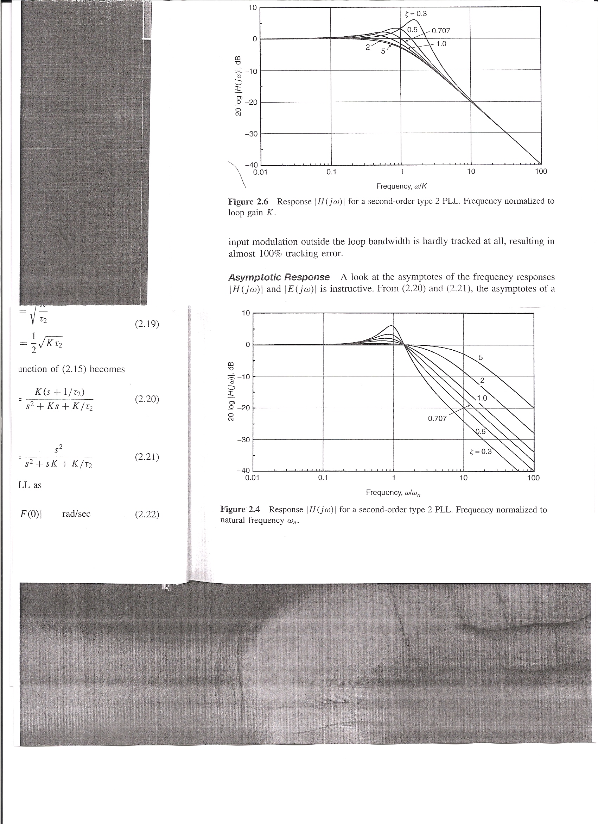
Bandwidth
Transfer function of Type-II PLL
Definition-1 : ωn
Definition-2 : 2ζωn
Approaches 3dB frequency as ζ increases

Slide 15
۞ ζ and ωn
Closed Loop
ζ : damping ratio
ωn : natural frequency
ζ > 1 : real poles
overdamped
ζ = 1 : duplicated poles
critically damped
ζ < 1 : complex poles
under damped
ωn : natural undamped frequency
=> oscillation frequency when ζ = 0
higher ζ : more stable

Slide 16
Jitter and Loop Bandwidth
noise
up
freq_in
Vc
PFD
CP & LF
VCO
freq_out
dn
Low freq. noise : Device remains with characteristics changed for several cycles.
=> Frequency error for long period of time
Noise induced
Jitter accumulated

Slide 17
Freq. Noise and Phase Noise
Transistor freq. noise
Osc. phase noise
1/f³
(30dB/dec)
1/f noise
Thermal noise
1/f²
(20dB/dec)
Δf
Δf
Corner freq
(Khz ~ Mhz)
Corner freq
X 1/f²
Freq. noise
Phase noise
Fluctuations of instantaneous frequency
Low-freq phase noise should be removed by PLL feedback loop.
As BW becomes larger,
better for VCO noise filtering but worse for input jitter filtering.

Slide 18
Failure of Continuous Time Approximation in Stability
IP
up
Io
LF
clk_in
PFD
VCO
clk_out
dn
IP
When the same phase error is applied with different frequency :
clk_in
1) High freq. input
clk_out
Io
Comparison results updated frequently
clk_in
2) Low
freq. input
clk_out
Io
One big output
=> BW should be reduced further.
Typically recommended loop BW < ~ 0.1 x freq_in

Slide 19
Phase Frequency Detector
Linear (Phase+Frequency)Detector
Phase Detection
‘1’
D
φ1
Q
up
φ1
φ2
reset
up
φ2
τm
dn
Q
dn
τm
‘1’
D
Frequency Detection
φ1
φ2
T(up-dn)
up
dn
-2π
Δφ
2π

Slide 20
Non-Ideal Effects : Mismatch in Pumping Current
Locked State
Ipu
clk_in
up
clk_out
VC
up
dn
dn
Ipd
Ipd
Ipu
same area in locked state
Charge pump output is regarded as the result of phase comparison.
up/dn current mismatch causes phase offset.
Current mismatch affects much if linear PD is used.

Slide 21
Non-Ideal Effects : Minimum Pulse-Width
around locked state
IP
‘1’
up
up & dn
as τm decreases
D
Q
φ1
reset
Io
VC
φ2
τm
‘1’
D
Q
Io
dn
IP
When τm is very small, dead zone occurs.
IP
Δφ
-IP
As τm increases,
- Phase offset increases when up/dn current mismatches.
- Slow tracking.
τm should be set to be the minimum which guarantees switching operation.

Slide 22
Non-Ideal Effects : Charge Sharing
VDD
VDD
A
UP
CA
VC
DN
B
Vbias
CB
Compensating Up pulse
DN
UP
A
VC
B

Slide 23
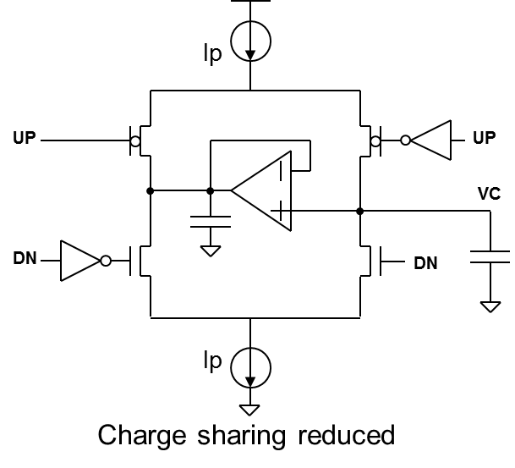
Charge Pump

Slide 24
Ring VCO
VC
ω
KVCO
VC
Small KVCO for small jitter
Linearity is preferred.
Differential Delay Cells
Replica Bias for Delay Cell
OUT
OUT
OUT
OUT
IN
IN
Vref
IN
IN
VC
VC

Slide 25
Inverter Type Ring VCO
Regulator
VDD
To reduce effect of VDD fluctuation
VC
Inverter Type Multiphase VCO
VC
(from regulator)

Slide 26
Level Shifters for Ring VCO Output
V2
No DC current
Duty distorted when V1 much differs from V2.
o
o
in
in
Level shifter is needed to convert VCO output to CMOS level.
V2
DC current flows when in=high.
Less distortion than latch type
Large current required for less duty distortion.
in/in
V1
0
o
V2
in
in
o/o
0
C
V2
in
o
R
DC current flows in bias circuit.
If V2 is significantly larger than V1,
DC current flows at conversion inverter.
Input signal should be clock or DC balanced.
RC >> period of clock
V2

Slide 27
LC Resonance
i
C
L
V_{C}
V_{L}
V_{C}+V_{L}=0 if Z_{C} = -Z_{L}
⬄ 1/jωC = jωL
⬄ ω = 1/√LC = ω_{o}
Resonance condition for i of ω_{o}
i
ω_{o}

Slide 28
V2
V2
V1
V1
V2
V2
V1
V1
V2
V2
V1
V1
V2
V2

Slide 29
LC Oscillators
V1
V2
V1
V2
V1
V1
V2
V2
V2
Ro
Hartley oscillator
V1
V1
gm*Ro > V2/V1
V1
V2
V2
Colpitts oscillator

Slide 30
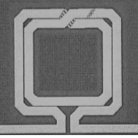
VCO - LC Oscillator
VDD
Cj
zero-bias capacitance
VC
reverse bias voltage across junction
O
O
built-in potential
empirical parameter 0.3~0.5
O
VDD
VC should be set for diodes to operate in reverse bias region.
Swing is controlled by tail current
O
VDD
VS
VDD
VG
VC
VC
O
O
O
O
n+
n+
N-well
P-sub

Slide 31
PLL Design Procedure
1. Set to a critically damped system for fast locking
=> ζ = 1
2. Choose an ω_{n} from BW requirement
i) Continuous-time system approximation
=> ω_{n} << ω_{in}/10
ii) For 1/f noise suppression, BW(HZ) > ~ 1Mhz
=> ω_{n} > 2π*1Mhz
3. Define Kvco considering all the process variations (ss, tt, ff)
(Note : dimension of K_{VCO} ~ rad/V.s)
4. Set a typical value for Ip (ex. ~ 100uA)
5. Derive C1 from
6. Derive R1 from
7. Set C2 ~ C1/10
8. Fine tuning with gain-phase margin analysis
9. If a regulator is used, check if the regulator bandwidth is larger than 10xPLL BW.
R1
C2
C1

Slide 32
Frequency Multiplication by PLL or DLL
up
freq_in
Vc
PFD
CP & LPF
VCO
freq_out
dn
Div M
MDLL
Div M
PFD
& CP
LF
f_in
Injection Locked VCO
f_out

Slide 33
Digital PLL

Slide 34
Analog PLL vs. Digital PLL
PFD
IP
CP
‘1’
D
up
φi
Q
VCO
reset
Io
Analog PLL
Q
φo
‘1’
D
dn
IP
Loop filter
DIV N
φi
Digital
Loop
Filter
φo
Digital PLL
DCO
TDC
Div N
Digital PLL : PLL whose loop filter is a digital filter

Slide 35
Block Diagram of DPLL
Two sources of quantization error : TDC, DCO
f_{REF}
Digital
Loop
Filter
DSM
DCO
f_{OUT}
TDC
Div M
Div N
DCO Equivalent
DCO (D/A conversion)
- Resolution improved by high-speed dithering with DSM.
TDC (A/D conversion)
- Wide conv. range for fast acquisition
- Fine resolution for low output jitter
Advantages of DPLL
- No charge pump noise
- No leakage in loop filter

Slide 36
DSM - Concept
Assuming error at DC
Error injected before integrator
Error injected after integrator
error
error
+
+
In
+
A
Out
In
+
A
B
+
Out
-
-
At steady state :
Case 1) In = 1, error = 0.1
=> A = 0, Out = 1.1
Case 2) In = 1, error = 0.2
=> A = 0, Out = 1.2
Case 3) In = 1, error = k
=> A = 0, Out = 1+k
ΣΔ
At steady state :
Case 1) In = 1, error = 0.1
=> A = 0, B = 0.9, Out = 1
Case 2) In = 1, error = 0.2
=> A = 0, B = 0.8, Out = 1
Case 3) In = 1, error = k
=> A = 0, B = 1-k, Out = 1
Out tracks error
Error is not seen at Out

Slide 37
Delay Measurement (Time-to-Digital Converter)
CLK_var
D
Q
D
Q
D
Q
D
Q
D
Q
D
Q
CLK_ref
Thermometer
code
Edge detector

Slide 38
Digitally Controlled Oscillator

Slide 39
Continuous-System Model of Digital PLL
+
φi
φi
Z(s)
φo
-
DIV N
rad/s(bit)
Digital
Hz
1/rad
None
(bit)
None
(scale)
rad/V.s
Recall Analog
Hz
1/rad
V

Slide 40
Digital Loop Filter
Io
α
VO
VR
to DCO
VC
β
Q
D
CK
Analog
Digital
Bilinear transform
[V. Kratyuk, TCAS2, 2007]

Slide 41
Set Coefficients from Phase Margin
[V. Kratyuk, TCAS2, 2007]

Slide 42
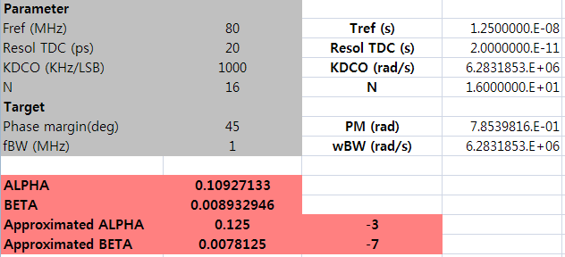
Design Example
Powers of 2

Slide 43
TDC-less Digital PLL with BB-PFD
Limit cycle : An isolated closed trajectory of phase-frequency plane
A self-sustained oscillation with a period
Δω
Δω
Δφ
Δφ
Stable
Unstable
Smaller size of circle
=> smaller jitter
Conditions for stable limit cycles
=> See [N. Dalt, TCAS-I, 2005]

Slide 44
Limit Cycle of Digital PLL with BB-PFD
φ_{REF}
BB
PFD
±1
α
z^{-D}
DCO
φ_{O}
β
z⁻¹
DIV N
Major factors : D, β, α
D : latency in feedback
Small β, α : Slow recovery of error
Large β, α : Large change even at small error
Effect of limit cycle
Phase noise
(dBc/Hz)
Log(f)
Optimization with extensive simulations is needed.

Slide 45
Noise Sources
Sn_{TDC}
Sn_{DCO}
20dB/dec
n_{TDC}(t)
f
n_{DCO}
f
rad
s
+
φref
Z(s)
φo
-
DIV N
TDC quantization
Low pass filter with passband gain=1
DCO 1/f noise
High pass filter with passband gain=1

Slide 46
Spectrum of TDC Quantization Noise
11
Digital output
10
01
00
Analog input
Δ
2Δ
3Δ
quantization error
not a function of sampling rate
quantized
level
target
Suppose a pitcher throws a ball into target in every Ts assuming uniformly distributed in target.
lowest freq. component = DC
N(f) : noise spectrum
target
zone
Ts
2Ts
3Ts
4Ts
5Ts
6Ts
7Ts
highest freq. component = fs/2
target
zone
-fs
-fs/2
fs/2
fs
Ts
2Ts
3Ts
4Ts
5Ts
6Ts
7Ts
Nyquist sampler : fmax = fs/2
Quantization noise power, Δ²/12, is uniformly distributed from DC to fs/2

Slide 47
Spectrum
=1 @ in-band
In-band noise (dBc/Hz)
Noise power by DCO
TDC noise
20dB/dec(1st order roll-off)
Phase noise
(dBc/Hz)
40dB/dec(2nd order roll-off)
DCO noise
Log(f)

Slide 48
Ex) In-Band Noise Calculation
Fref =50MHz => Tref = 20ns
Output frequency = 2 GHz => Tdco = 500ps
TDC resolution = 10ps
In-band noise =
= 3.29 * (10/500)² * 20*10⁻⁹ =2.63*10⁻¹¹
=> 10 log (2.63*10⁻¹¹) = -105.8dBc/Hz

Slide 49
Clock and Data Recovery

Slide 50
PLL-Based CDR
Both clock and data are recovered from data transition information.
rDo
CP
IP
up
Din
PD
Vc
rCK
VCO
dn
IP
LPF
Two functions of PD
- Phase detection
- Data detection
Loop dynamics are similar to those of PLL.

Slide 51
Linear PD (Hogge PD)
UP
A
DN
Din
D Q
D Q
B
CK
B is delayed A by half clock period.
CK early
CK late
Din
Din
CK
CK
A
A
B
B
UP
UP
DN
DN
Rising edge of CK is to be at the middle of Din window.
Pulse width of DN is fixed. => half clock period
Difference in UP/DN pulse width is proportional to phase error.

Slide 52
Binary PD (Alexander PD)
DN
Din is not directly applied to XOR
D Q
A
D Q
B
Din
UP
CK
Bang-bang type PD
D Q
C
D Q
D
CK early
CK late
B
D
A
B
D
A
Din
Din
CK
CK
A
A
B
B
C
C
D
D
UP
UP
DN
DN
Rising edge of CK is to be at the middle of Din window.
Each transition of Din makes one clock-period pulse.

Slide 53
Comparison
When PD experiences data transition under locked condition :
Hogge PD
Alexander PD
UP
UP
DN
DN
Vc
Vc
Ripple on Vc can be further reduced by circuit technique. => good for jitter
Vc fluctuates more.
=> possibly worse in jitter performance
High-speed circuit implementation is needed.
Released switching time constraints of charge pump
Easier choice for high-speed application by time-interleaving circuit technique
۞ In optical standards, jitter is expressed in terms of UI(unit interval).
Ex) 0.01UI = 10% of bit period

Slide 54
Binary PD with Multiphase Clocks
Clock Frequency = (Data Rate)/4
Quarter-Rate Binary PD
Din
Din
Retimer
φ0
φ0
φ0
φ1
φ0
D Q
u0
φ2
D Q
D Q
φ3
φ1
D Q
d1
φ4
D Q
D Q
φ5
φ2
D Q
u2
φ6
D Q
D Q
φ7
φ3
D Q
d3
up
u0
D Q
D Q
φ4
D Q
u4
dn
d1
D Q
D Q
u2
φ5
D Q
d5
d3
D Q
D Q
u4
φ6
D Q
u6
D Q
D Q
d5
φ7
D Q
d7
u6
D Q
D Q
d7
φ4
T1
T1
T2
T2

Slide 55
Linearized Gain of BBPD
+1
Δφ
BBPD
±1
Δφ
Δ1
Δ2
Δ3
-1
Output is not proportional to input => nonlinear
Gain defined by input statistics => inversely proportional to σ
+0.5
Δφ
-0.5
BBPD gain : Transition density (0.5) x Slope of average PD output vs. φ

Slide 56


Gain of BBPD
Gaussian
Uniform
K_{PD} = $\frac{1}{σ\sqrt{12}}$
K_{PD} = $\frac{1}{σ\sqrt{2π}}$

Slide 57
Limited Pull-In Range with PD-Only
Din
PD
CP
LF
VCO
rCLK
rDo
Data Rate = VCO freq.
|φo/φi|
Din
Recall
noise BW
CLK
PD output
dn
dn
dn
dn
dn
dn
dn
dn
2ζωn
ω
Data Rate ≠ VCO freq.
φ1
φ2
PD output
dn
dn
up
up
dn
dn
up
Frequency error accumulates phase error.
=> If phase error exceeds 180°, PD generates wrong output.
VCO frequency should be corrected quickly by updating VCO input.
=> By increasing BW, some frequency error can be adjusted.
Tradeoff
Higher bandwidth => Increased pull-in range, Worse noise filtering

Slide 58
Implementation of Wider Pull-In Range
FD
CP
Din
VCO
LPF
PD
CP
Additional frequency loop simultaneously operates with data recovery loop.
Din
PD
CP
Lock
Detector
2
LPF
VCO
1
fref
PFD
CP
VCO frequency initially adjusted close to data rate by a PLL loop.
=> Reference clock should be additionally applied.

Slide 59
Frequency Detection
A
i) ω1 > ω2 : A leads B by 90°
ii) ω1 < ω2 : B leads A by 90°
B
Bang-bang type FD
D Q
A
D Q
CKI
out
out
fo < r
fo > r
Din
D Q
B
CKQ
Clock frequency : fo
Input data rate : r
double-edge triggered D-flipflop

Slide 60
Clock and Data Recovery Loop
Referenceless CDR
FD
CP
F_loop
F_loop : frequency loop
Din
VCO
LPF
P_loop
P_loop : phase loop
PD
CP
rDo
Since PD dose not operate appropriately when clock frequency differs from data rate, frequency locking loop is necessary before phase detection.
If two loops interact strongly, system may be unstable.
One loop should be dominant in locking.
Typically BW of P_loop >> BW of F_loop
=> Independent control of BW is needed.

Slide 61
Bandwidth of Frequency Loop
phase shift
0° shift
freq_in
Vc
FD
LPF
VCO
freq_out ∝ Vc
= KVCO Vc
Only phase-lagging source : LPF
Since frequency loop is single-pole system, loop is unconditionally stable.
Recall from DLL transfer function
Assuming linear FD and simple capacitor for LPF,
the transfer function of frequency locked loop is

Slide 62
Independent Control of BWs
LPF of CDR
from PD
CP
Rp
from FD
CP
C2
Cp
BW of Phase loop
BW of Frequency loop
(Rp has no effect)
Increase of Cp also makes BW of P_loop >> BW of F_loop.

Slide 63
Frequency Lock Detector
Target
reference
clock
reset
Compare
Locked
D Q
Counter
VCO/N
(shifted phase)
Histerisis is not implemented.
This lock detector is used for CDR which adjusts frequency only at initialization.
=> One-time lock detection
If CDR loses lock, it restarts from initialization.(i.e. PLL -> lock detection -> P-loop)

Slide 64
Phase Rotator Based CDR
Both clock and data are recovered from data transition information.
rDo
CP
Fref
: can be slightly different from data rate.
IP
up
0
Din
PD
LPF
Interpolator
Cap. only
dn
rCK
IP
Q
rCK
I
I
Q

Slide 65
Example
Ref CLK
PLL
0
iclk
up
Interpolator
Counter
iclk
dn
qclk
Interpolator
qclk
p0
iclk
p1
p2
qclk
Din
p3
Binary
PD
p4
iclk
p5
p6
qclk
p7

Slide 66
Counter & Interpolator
C3-0
C5,4=00
C5,4=01
C5,4=10
C5,4=11
Q
C3-0
01
C5,4
=00
I
I
10
11
count up
I
Q
Q
I
Q
output
D3-D0
C3-0
C3-0
C3-0
C3-0
VDD
C5 C4 sel_I sel_Q
0 0 1 1
0 1 0 1
1 0 0 0
1 1 1 0
I
I
I
I
Q
Q
Q
Q
sel_I
sel_I
sel_Q
sel_Q
D3
D2
D1
D0
D3
D2
D1
D0
VB
x8
x4
x2
x1
VB
x8
x4
x2
x1

Slide 67
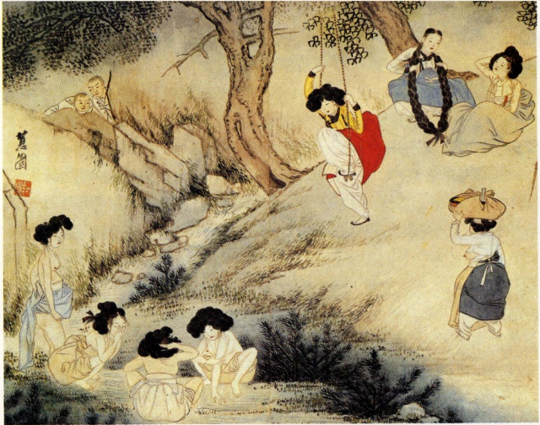

Slide 68
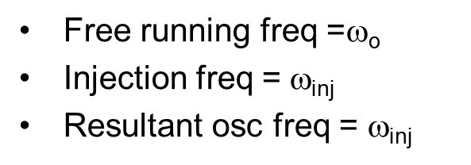
Injection Lock
I_{osc}
I_{inj}
Injection
Frequency
Phase
I_{osc}
Free running freq =$\text{}\text{o}$
Injection freq = $\text{}\text{inj}$
Resultant osc freq = $\text{}\text{inj}$
θ
I_{inj}
[B. Razavi, JSSC 2004]
Injection strength (k) = I_{inj}/I_{osc}

Slide 69


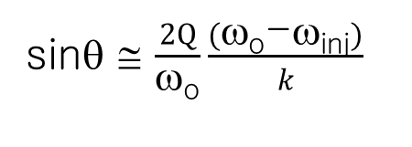



Phase Control by Injection
sinθ ≅ $\frac{2Q}{\text{ω}\text{o}}\frac{(\text{ω}\text{o}\text{−}\text{ω}\text{inj})}{k}$
θ
$$\text{/2}$$
$$−k\text{ω}\text{o}\text{/2}\text{Q}$$
$$\text{}\text{o}\text{−ω}\text{inj}$$
$$k\text{ω}\text{o}\text{/2}\text{Q}$$
$$−π\text{/2}$$
[B. Razavi, JSSC 2004]

Slide 70
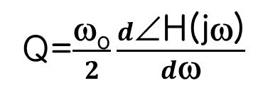
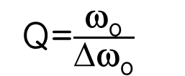
Definitions of Q
|H(jω)|
I
|H(jω)|
|H(jω_{o})|=1
∠H(jω_{o})=0
∠H(jω)
3dB
Δω
ω_{o}
ω_{o}
Q=$\frac{\text{ω}\text{o}}{Δ\text{ω}\text{o}}$
Q=$\frac{\text{ω}\text{o}}{2}\frac{d\text{∠}\text{H}\text{(}\text{j}\text{ω)}}{d\text{ω}}$
@ω=ω_{o}
Can be applied to ring osc.

Slide 71
Clock Forwarded Receiver with Injection Locking
[K. Hu, JSSC 2010]
Data
Sampler
rData
rCLK
IL
OSC
Freq.
Ctrl.
Inj
CLK
Inj+
Inj-
Inj.
strength
Freq. Ctrl.

Slide 72
Injection Locking in PLL
φ_{REF}
PFD
&CP
Inj
LF
φ_{O}
VCO
DIV N
Noise model
[S. Ye, JSSC 2002]
φ_{REF}
H_{up}(s)
φ_{VCO}
PFD
&CP
K_{vco}/s
φ_{O}
LF(s)
H_{rl}(s)
DIV N

Slide 73
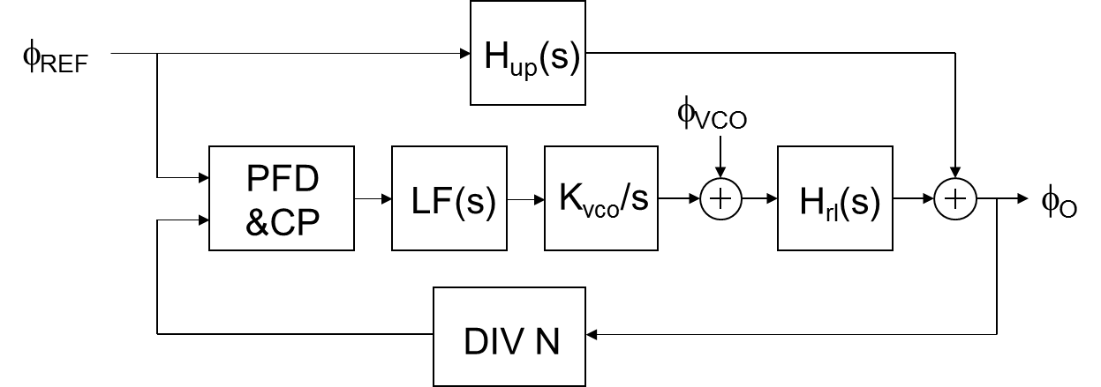
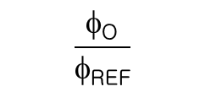
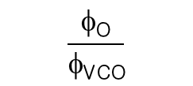
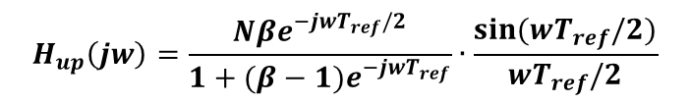
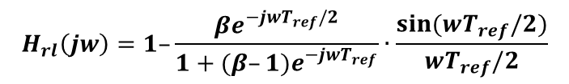
Noise Behavior of Injection Locked PLL
[S. Ye, JSSC 2002]
$$H_{up}\left(jw\right)=\frac{Nβe^{−jwT_{ref}/2}}{1+(β−1)e^{−jwT_{ref}}}∙\frac{sin(wT_{ref}/2)}{wT_{ref}/2}$$
$$H_{rl}\left(jw\right)=1–\frac{βe^{−jwT_{ref}/2}}{1+(β–1)e^{−jwT_{ref}}}∙\frac{sin(wT_{ref}/2)}{wT_{ref}/2}$$
Simulated transfer functions (N=32)
$$\frac{φ\text{O}}{φ\text{REF}}$$
$$\frac{φ\text{O}}{φ\text{VCO}}$$

Slide 74
PR-Based Digital CDR with 1st Order LF
Example ) Simple counter as a LF
UP
Din
PD
(Sampler)
Decimation
UP/DN
Counter
DN
4
Recovered data
2
Interpolator
2
Interpolator
0˚
90˚
180˚
270˚
Definition of digital CDR : LF implemented by a digital filter
Frequency offset in data rate
- Ramp input in phase
- Steady state error in phase lock => finite phase offset
- Trade-off : Tolerable frequency offset vs. interpolator resolution

Slide 75
PR-Based Digital CDR with 2nd Order LF
UP
Din
PD
(Sampler)
Decimation
UP/DN
K_{P} + K_{I}/(1-z⁻¹)
DN
4
DLF
Recovered data
Σ
2
Interpolator
2
Interpolator
0˚
90˚
180˚
270˚
P-I control by a digital loop filter(DLF)
Frequency offset
- K_{I} rotates phase
- Zero steady state phase error

Slide 76
PR-Based CDR with Direct Pulling of DCO
Direct pulling
rDo
rCK
Din
PD
(Sampler)
Decimation
UP/DN
Σ
DSM
DCO
Div M
Div N
TDC-less architecture
- PD as a 1bit TDC
- Proportional path : Direct pulling for low latency
- Integral path : Digital accumulation

Slide 77
Digital CDR with ADC-Based Blind Sampling
ADC
DSP
Equalization
Interpolation
Phase detection
Filtering
Data extraction
ADC
Din
ADC
ADC
Div N
Clock generator
High-speed flash ADCs with 4~5b
All digital implementation of CDR
Performance limiting factors
- Input cap
- Skew in multiphase sampling
- Large power consumption

Slide 78
Phase Noise &
Jitter Characterization

Slide 79
Jitter Definitions
average period
Period jitter : Difference from average period
Extended to N cycles
Long term jitter
(Accumulated jitter):for N periods
Cycle-to-cycle jitter : Difference between adjacent periods
Absolute jitter : Difference from ideal clock
Ideal clock = Chain of average periods

Slide 80
Measurement of RMS Jitter
RMS jitter = Standard deviation (σ) of jitter
Number of hits (N) required with a given confidence level
Confidence level
Q=1 : 68%
Q=2 : 95%
Q=3 : 99.7%
Ex) For less than 1% error in RMS jitter measurement with 68% confidence level
N ≥ 0.5*(1/0.01)² = 5000 hits

Slide 81
Phase Noise
Absolute jitter
PSD of ϕ : Phase noise (L(f))
L(f)
0-> Carrier frequency, fo

Slide 82
Freq. Noise and Phase Noise
Transistor freq. noise
Osc. phase noise
1/f³
(30dB/dec)
1/f noise
Thermal noise
1/f²
(20dB/dec)
Δf
Δf
Corner freq : 1 ~ 100Khz
Corner freq
X 1/f²
Freq. noise
Phase noise
Fluctuations of instantaneous frequency
Low-freq phase noise should be removed by PLL feedback loop.
As BW becomes larger,
better for VCO noise filtering but worse for input jitter filtering.

Slide 83
Absolute Jitter & Phase Noise
PSD of absolute jitter
Apply Wiener-Khinchin theorem

Slide 84
Period Jitter & Phase Noise
t1 : reference time
t1-t2 : ideal period
Apply Wiener-Khinchin theorem
High-pass filter if f < fo/2
=> Period jitter is mainly determined by high frequency phase noise.

Slide 85
Period Jitter of a Free-Running Oscillator
L(f)
Free-running oscillator
PLL output
~1/f² (20dB/dec)
L1
f
f_{BW}
f1
With any given L1 at f1,phase noise of a free-running oscillator can be derived as
L(f) = L1(f1/f)²
~ (πf/f_{o})²

Slide 86
Relations Among Jitters
If N is large (non correlated)
Free-running oscillator
Log(J_{rms,long-term})
Slope = 1/2
PLL output
Log(N)
fo/(2πf_{BW})
1/ω_{BW}=N*To

Slide 87
Jitter in Link : Estimation of Data Quality
Eye opening
A2
A1
(mV)
0
2*X1 : Jitter
-A1
-A2
0
X1
X2
1-X2
1-X1
1(UI)
1UI (Unit interval)
Peak-to-peak jitter is more meaningful since BER is affected by extreme cases.
Total jitter (TJ) = Random jitter (RJ) + Deterministic jitter (DJ)
Unbounded
Defined by σ
Bounded
Defined by peak-to-peak

Slide 88
Deterministic Jitter – 1
Data dependent jitter
Jitter histogram
Inter-symbol interference

Slide 89
Deterministic Jitter – 2
Sinusoidal jitter (periodic jitter)
Eye opening
PDF of sinusoids
Jitter histogram
Power supply fluctuation, RF interference, Spurs in PLL output

Slide 90
Deterministic Jitter – 3
Duty cycle distortion (DCD) in single-ended signaling
Ref
Jitter histogram
Specified by Vox (Output crossing point) parameter in DDR DRAM
- Mismatch in driving strength
- Skew in driving phases

Slide 91
Deterministic Jitter – 4
Far-end crosstalk on parallel microstrip line in single-ended signaling
Odd
mode
Even
mode
FEXT-induced jitter
Ro
Ro
V1
Victim
Ro
Ro
V2
Aggressor
Even mode
Odd mode
V1
V1
Inhomogeneous structure of microstrip line
: Inductive coupling ( ) > capacitive coupling ( )
V2
V2

Slide 92
Degradation of BER with Multiphase Clocks
QDR output when serializer is driven by skewed 4-phase clocks
A
B
A
B
Repeated eye pattern
Effective jitter : B-A
Need a quad-deskewing scheme in TX.
Deskewing is also required in RX when half-rate or quad-rate CDR is used.

Slide 93
Random Jitter
Thermal noise, Flicker noise, Composition of many uncorrelated noises
Gaussian distribution
Peak value is unbounded and increases as measurement period increases.
14σ for BER of 10⁻¹²
Gaussian
With a reference BER of 10⁻¹²,
TJ_{p-p} = 14*RJ_{rms} + DJ_{p-p}

Slide 94
Gaussian PDF (Random Jitter)
σ
3.09σ for Prob < 1e-3
4.75σ for Prob < 1e-6
6.00σ for Prob < 1e-9
7.03σ for Prob < 1e-12
7.95σ for Prob < 1e-15

Slide 95
Jitter Decomposition
Distribution of independent random variables’ sum
=> Convolution of single variables
RJ
DJ
TJ
Sum
Follows RJ distribution

Slide 96
Bathtub Curve & Jitter
Eye opening measurement by phase scanning with BERT
1UI
0.5
10⁻³
BER
10⁻⁶
10⁻⁹
RJ
RJ
10⁻¹²
time
DJ
DJ
Eye opening @BER of 10⁻¹²
With reference of BER(10⁻¹²),
TJ = 1UI – Eye opening @BER of 10⁻¹²

Slide 97
Jitter Generation
rD
Din
CDR
rCK
Definition :
Amount of jitter at output when jitter-free input is applied to the input.
Uses UI to quantify.
Meaning :
Measures intrinsic jitter due to thermal noise and drift of oscillator.
Specification of SONET : 0.1 UI (peak-to-peak), 0.01 UI (rms)

Slide 98
Jitter Transfer
CDR
Definition :
Ratio (in dB) between input jitter and output jitter.
Usually drawn as a function of jitter frequency.
Meaning :
Confirms there is little amplification of jitter even if multiple CDR circuits are used by cascading in long-distance transmission system.
0.1dB
Jitter transfer mask for OC-192
Acceptable
region
-20dB/decade
gain
jitter frequency
8MHz

Slide 99
Jitter Tolerance
CDR
BERT
Definition :
The maximum amount of jitter (in UI) allowed for specified BER(ex. 10⁻¹²)
Usually drawn as a function of jitter frequency
Meaning :
Confirms CDR works well in the worst-case jitter from preceding sections.
15UI
Acceptable
region
Jitter tolerance mask for OC-192
1.5UI
0.15UI
jitter frequency
2.4K
24K
400K
4M

